Slide 1
Pain Management Strategies for Primary Care
David Buyck, Ph.D.
Sarah Lucas Hartley, Ph.D.
Salem Veterans Administration Medical Center
Notes:
Pain Outline
Secondary gain - disability
Dual diagnosis issues. Comorbidity with PDs, MDD, ANX, PTSD (accident pain, etc).
Personality factors associated with difficulty with pain
Importance of a complete psychosocial assessment
Diagnostic categories and limitations
Motivating clients for treatment
Education about pain
Group & Group & individual
Contraindications for tx
Medications
Herbal, misuse, undermedication
Fibromyalgia
Somatoform disorders
Reimbursement
Building a collaborative relationship with medical practitioners – what kind of info to ask for & give

Slide 2
Learning Objectives
Theoretical and historical influences.
Knowledge of assessment strategies and criteria.
Familiarity with treatment strategies.

Slide 3
Defining Chronic Pain
Chronic Pain
Physical pain of a duration greater than 6 months
This presentation will focus on Chronic Pain
Acute Pain
Physical pain of a duration less than 6 months
Some utility of ψ here but less than for Chronic Pain

Slide 4
Categories of Chronic Pain
Chronic recurrent pain
Benign condition
Intense pain alternating with pain-free periods
E.g., Headaches, endometriosis
Chronic intractable benign pain
Benign condition
Persistent - no pain free periods
Intensity may vary
Objective medical findings often limited
E.g., Back pain
Chronic progressive pain
Malignant condition
Continuous - increasing intensity
E.g., Cancer and rheumatoid arthritis

Slide 5
Prevalence and Incidence
10-15% of Americans are disabled due to back pain alone (DSM-IV).
70,000,000 Americans will seek pain treatment in a given year (Gatchel & Weisberg, 2000).
4 out of 5 clinicians agree that you shouldn’t trust any of these statistics.

Slide 6
Pain Prevalence in the VA
50% of the VA population suffers CP.
Prevalence is growing:
42.7% of OIF/OEF enrollees report chronic pain.
Most frequent OIF/OEF diagnoses are diseases of the Musculoskeletal system.

Slide 7
Co-morbidity of Chronic Pain & Mental Illness
15.4% Psychiatric Illness base rate.
51-58% Rate of Psychiatric Illnesses among patients with CP.
4X the prevalence of general population.
In the VA, over 80% of PTSD patients have co-morbid CP.
>20% of patients on VA SUD inpatient programs have CP.

Slide 8
...we are not ourselves when nature, being oppressed, commands the mind to suffer with the body. Shakespeare, King Lear

Slide 9
Costs to Patients and Society
Often compromises all aspects of life
Elusive quest for relief
Demoralization, helplessness, hopelessness
Grief
Taxes relationships
Frustration for health care providers
Chronic pain is incompatible with societal myths
Perpetuation of stereotypes
Addiction
Opportunity costs to GNP
Often given severely limited resources due to surreptitious or inadvertent ageism and fear.

Slide 10
Historical Influences
Aristotle (384-322 BC) - DeAnima- “Pain is a quality of the soul.”
1640’s Renaissance – Descartes dualistic.
1895 – Freud - psychosomatics.

Slide 11
Iceman of the Alps “Utze”
Oldest, best preserved corpse.
5300 years old.
Daniel Carr, M.D. & A.P.S.

Slide 12
Emergence of Psychosomatic Medicine
1956 – Beecher- soldiers & civilians.
1965 - gate control theory - Melzack & Wall.
The health belief model (US Public Health Service, Late 50’s )
Voluntary control of ANS (i.e., Biofeedback)- Basmajian (1963); Miller (1969).

Slide 13
Emergence of Psychosomatic Medicine
1976 - Operant conditioning - Fordyce
model of “pain behavior”
“activity intolerance”
Cognitive-behavioral, importance of:
appraisal,
beliefs and
expectations.
1999 – Uhl, Sora & Wang –identified “pain sensitivity gene.”

Slide 14
Gate Control Theory
Ronald Melzack & Patrick Wall (1965)
Diverse factors in pain perception
Importance of CNS & psychological factors
Melzack’s current research: “body-self neuromatrix”
Cortical Neuroplasticity (Apkarian, Bushnell, Merzenich, Zhou)

Slide 15
Controlling the Gate
 | Openers | Closers
Physical | Injury Extent Inappropriate Activity Level Tension | Medication Counter- stimulation
Affective | Anxiety Depression | Positive Emotions Relaxation
Mental | Focus on Pain Boredom | Concentration Involvement

Slide 16
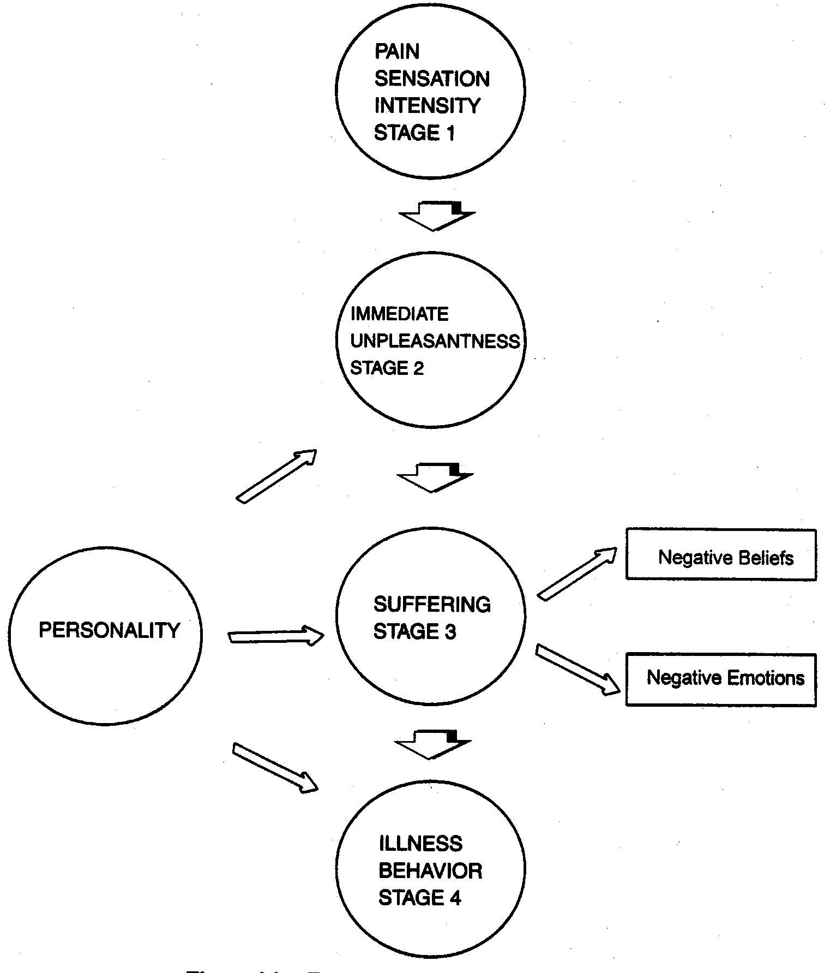
The 4-Stage Integrated Model (Price, 1988; Wade, Dougherty, & Archer, 1996)

Slide 17
Why Integrate
50% of the VA population suffers CP.
Primary Care handles pain management longitudinally.
Behavioral aspects around Pain Management:
Always #1 PC need on NGP and needs assessments
No-shows for ancillary referrals are high.

Slide 18
MHI Pain Strategy
No referral needed
MHI Screens/Triages – Open-Access
Moves to group/BMed in Same Week
MI/Integrated support around adherence issues

Slide 19
Rules for Group Inclusion
Patients must:
Express willingness and motivation to attend
Be free of active substance or alcohol abuse or dependence
Be in concurrent, active, effective treatment if they meet criteria for any mental disorder (including personality disorders)
Be free of active current psychosis, mania, suicidal or homicidal ideation.
These conditions will need to be stabilized in specialty mental health care prior to pain group admission
Limitations of treatment:
It can be helpful to inform patients during the screening encounter that we are not prescribers and do not offer medications, surgeries, and that we cannot influence medical decisions.

Slide 20
Pain Psychology Triage in Primary Care
Primary Care Provider
Chronic Pain Management Group
MHI
MHI Managed

Slide 21
Pain Psychology Triage in Primary Care
PCP
MHI
Chronic Pain Group
MHI Managed

Slide 22
Key MI Issues
Agenda setting/active listening.
ψ referral may reinforce fear that provider believes its “all in my head.”
Convey that pain influences most aspects of life.
Full psychophysiological understanding.
“Behavioral medicine” vs. “Psychological evaluation”
Stress interferes with physical recovery.
Limitations of treatment.

Slide 23
The Waddell Signs
Tail bone pain in a patient with a back injury.
Whole leg pain except diabetic or alcoholic neuropathy.
Whole leg numbness, except in diabetic or alcoholic neuropathy.
Whole leg giving way.
Absence of pain free periods.
Intolerance and reactions to treatment.
Hospital admission for simple low back pain.

Slide 24
Waddell Signs
Waddell signs “do not directly measure faking, but point to psychological suffering or unconscious neurotic behavior. If patients with high Waddell scores do not receive psychological intervention, they probably will not improve”. - Waddell

Slide 25
Signs of Narcotic Dependence & “Drug Seeking”
Multiple lost or stolen scripts
Multiple pharmacies and/or physician prescribers
Multiple dose escalations despite adverse effects
Focused only on medication types or doses
Unwilling to consider or try non-opioid therapy
Consistently running out of medications early
Frequent calls, especially after hours
Agitation at providers over medications
Illicit drugs on screens
Injecting oral narcotics
Prescription forgery
Steeling or borrowing drugs from others
Selling prescription drugs

Slide 26
Signs of Pseudo-addiction (seeking adequate pain relief)
Escalating doses without improved analgesia
High doses without concern of side-effects
Withdrawal symptoms
Hoarding when symptoms are reduced
Acceptance of non-opioid regimens
Frequent request to modify regimen to produce relief
Requesting specific narcotics
Dose escalation without physician consent once or twice
Notes:
Portenoy (1996) J Pain Symptom Management

Slide 27
Psychological Goals in Pain Treatment
Increase coping with pain sensation
Increase coping with threat to functioning
Reduce associated emotional distress

Slide 28
Typical CBT Pain Format Keefe, Jacobs & Underwood-Gordon (1997)
Educational component.
Recognizing & challenging irrational beliefs.
Instruction in behavioral skills.
Identification of & planning for high-risk situations.
Decision making & problem solving re: employment, relationships, etc.

Slide 29
Our Group Format
10 general topics
Pacing
Becoming more active
Re-thinking & outsmarting pain
Relaxation & stress management
Getting in better shape
Re-claiming recreation & work
Dealing with family and friends
Healthy habits
Social activity
Working with health-care providers

Slide 30
Psychological Goals in Pain Treatment
Increase coping with pain sensation
Increase coping with threat to functioning
Reduce associated emotional distress

Slide 31
Assumptions of CBT Turk & Rudy (1989); Bradley (1996)
Active processing of internal & environmental events
Thoughts ⇦⇨ behavior through emotional, physiological responses
Behavior ⇦⇨ environment
Treatment must address emotional, cognitive, behavioral and physiological
Active participation from patient
Notes:
Adapted from Turk & Rudy (1989); Bradley (1996)

Slide 32
Typical CBT Pain Format Keefe, Jacobs & Underwood-Gordon (1997)
Educational component.
Recognizing & challenging irrational beliefs.
Instruction in behavioral skills.
Identification of & planning for high-risk situations.
Decision making & problem solving re: employment, relationships, etc.

Slide 33
Educational Component
Assess what they already know.
“Take ‘em where they’re at.”
Pain’s purpose.
Example of Congenital analgesia.
Use analogies (nerves-wires).

Slide 34
Recognizing & Challenging Irrational Thoughts
Beliefs – “fix me doc.”
Automatic reactive patterns.
E.g., Flare-up =  anger, tension, resentment.
Motivational attitudes.
Internal vs external LOC.
Stages of change (Prochaska & DiClemente, 1982; Jensen, Neilson, and Kerns, 2003; Glenn, B. & Burns, J, 2003).
Reframing – “It’s not in your head, but you can use your head to help deal with it.”
Notes:
Prochaska, J.O., & DiClemente, C.C. (1982). Transtheoretical therapy toward a more integrative model of change. Psychotherapy: Theory, Research and Practice, 19(3), 276-287.

Slide 35
Instruction in Behavioral Skills
Relaxation
Imagery-hypnotic analgesia
Distraction
Listing pain behaviors & responses

Slide 36
Instruction in Behavioral Skills
Exercise
Pacing
Assertiveness
Practiced in session then as homework
Self-monitoring & self-reinforcement

Slide 37
Planning for High-risk Situations
Flare-up plans (pre-emptive analgesia)
Work & home stressors
Emotional upsets
Relapse prevention
Teach to recognize early signs (depression, anxiety, pain, diet, exercise)
Rehearsal of responses
Self-reinforcement training

Slide 38
Decision Making & Problem Solving
Indicators of poor problem solving.
Generation of few possible solutions.
Suggested solutions don’t include social supports.
Inaccurate expectations of probable consequences.

Slide 39
Decision Making & Problem Solving
Steps for problem solving.
Acknowledge & identify problem.
Ask who owns the problem.
Identify needs of those affected.
Identify resources.
Brainstorming.
Evaluate options based on step 3.
Implement an option.
Evaluate outcome.

Slide 40
CBT Group Treatment
Advantages
Fixed format
Social facilitation
“We are not alone”
Veteran phenomenon
Integrative
 & $
Disadvantages
Relatively inflexible
Crises more challenging
Not as individualized
Can be threatening

Slide 41
The End

Slide 42
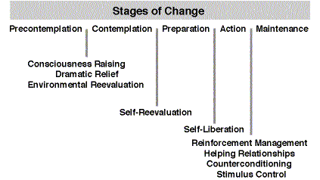
Transtheoretical Model
Notes:
Source: Prochaska, J.O., DiClemente, C.C. and Norcross, J.C. (1992). In search of how people change -- applications to addictive behaviors. American Psychologist, 47(9), 1102-1114.

Slide 43
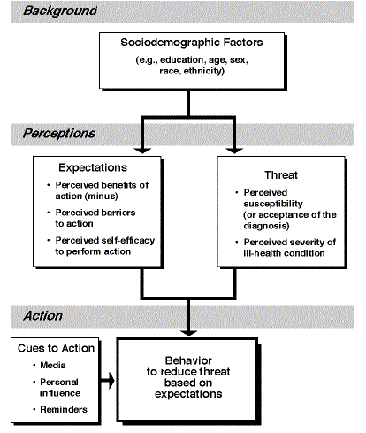
The Health Belief Model

