Slide 1
Patient Aligned Care Team VHA’s implementation of the Patient Centered Medical Home
David A. Hunsinger, MD, MSHA
Medical Director, Binghamton VA Outpatient Clinic

Slide 2
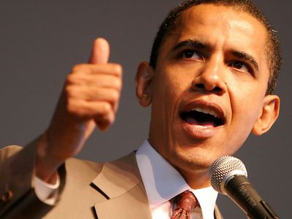
Statement on the PCMH: President Obama
“I support the concept of a patient-centered medical home, and as part of my health care plan, I will encourage and provide appropriate payment for providers who implement the medical home model, including physician-directed, interdisciplinary teams, care management and care coordination programs, quality assurance mechanisms, and health IT systems which collectively will help to improve care.”
President Barack Obama

Slide 3
Joint Principles of the Patient-Centered Medical Home AAFP, AAP, ACP, AOA
Ongoing relationship with personal physician
Physician directed medical practice
Whole person orientation
Enhanced access to care
Coordinated care across the health system
Quality and safety
Payment
3
Notes:
PCMH not an invention of VA
Well researched and supported by a variety of specialty associations

Slide 4
Principle 1 Personal Physician (Provider)
Every patient has a designated primary care provider.
Relationship is ongoing – continuous over time
Patient choice
Each physician has a “Panel” of patients

Slide 5
Principle 2 Physician (Provider) Directed
Provide clinical direction
Shared-Decision making
Team-based care, leading the team
Flattening the hierarchical structures
Equal Value, Different Roles
Championing principles of Medical Home
Example: Facilitating Care Coordination

Slide 6
Principle 3 Whole Person Orientation
Health as a focus, not just Health Care
Personal preferences of the patient drive care interventions
Patient self-management skills and education
Culturally relevant and sensitive
Shared goal setting with health care team
Health literacy and numeracy
Family engaged in care
Mental Health and Primary Care Integration
Notes:
Patient is a member of the team
Patient-centered care

Slide 7
Principle 4 Enhanced Access to Care
Open Access principles (ACA)
Ready and timely access to non face-to-face care
Telephone, Messaging, Secure e-mail
Web-based access to scheduling, information, records, labs
System Redesign

Slide 8
Principle 5 Coordinating Care
Transitions within and without
Identifying and managing highest risk
Chronic Disease Management
Population-based Health Care
Predicative Modeling
Health Risk Assessment Tools
Patient/Disease Registries

Slide 9
Principle 6 Quality and Safety
Clinical performance
Value = Quality/Cost
Medication reconciliation
Quality and Safety are outcomes
Effectively managing transitions
Team dynamic drives performance
Effective implementation of Medical Home
Data driven, team-based, system redesign
Continuous improvement

Slide 10
Patient Centered Medical Home
Access
Offer same day appointments
Increase shared medical appointments
Increase non-appointment care
Care Management & Coordination
Focus on high-risk pts:
Identify
Manage
Coordinate
Improve care for:
Prevention
Chronic disease
Improve transitions between PCMH and:
Inpatient
Specialty
Broader Team
Practice Redesign
Redesign team:
Roles
Tasks
Enhance:
Communication
Teamwork
Improve Processes:
Visit work
Non-visit work
Patient Centeredness: Mindset and Tools
Improvement: Systems Redesign, VA TAMMCS
Resources: Technology, Staff, Space, Community
Notes:
Vegas roll-out

Slide 11
Primary Care – Mental Health Integration
PC-MHI embodies the principles and focus of the Patient Centered Medical Home
Work on PC-MHI implementation facilitates PACT implementation

Slide 12
Principles of the Patient-Centered Medical Home
Ongoing relationship with personal physician
Physician directed medical practice
Whole person orientation
Enhanced access to care
Coordinated care across the health system
Quality and safety
Payment
12

Slide 13
Mental Health and Primary Care A Natural Fit
26% of Veterans who use VA health care are also being treated for a mental health diagnosis
20% currently receive some or all of that care in a specialty Mental Health setting
Patients initially bring their mental health concerns to Primary Care
Screening for mental health problems takes place in primary care [Clinical Reminders]
Referrals from Primary Care to Specialty Mental Health result in a high rate of no-shows

Slide 14
True Integration Features of PC-MHI
Completely integrated within primary care
Occupy the same space
Share the same resources
Participate in Team Meetings
Share responsibility for care of the whole patient

Slide 15
Patient Aligned Care Team: Objective
To improve patient satisfaction, clinical quality, safety and efficiencies by becoming a national leader in the delivery of primary care services through transformation to a medical home model of health care delivery.

Slide 16
Team Redesign The Patient’s Primary Care Team:
Teamlet: assigned to
±1200 patients (1 panel)
Provider
RN Care Manager
Clinical Associate
LPN
Medical Assistant
Health Tech
Clerk
Team members
Clinical Pharmacy Specialist
± 3 panels
Medical Social Work
± 2 panels
Nutrition
± 5 panels
Mental Health
Case Managers
Trainees

Slide 17
Other Team
Members
Teamlet: assigned to 1 panel (±1200 patients)
Provider
RN Care Mgr
Clinical Associate (LPN, MA, or Health Tech)
Clerk
Patient
For each parent facility
HPDP Program Manager
Health Behavior Coordinator
My HealtheVet Coordinator
Other Team Members
Pharmacy
Social Work
Nutrition
Case Managers
Integrated Behavioral Health
Panel size adjusted for rooms and staffing
* The Patient Aligned Care Team

Slide 18
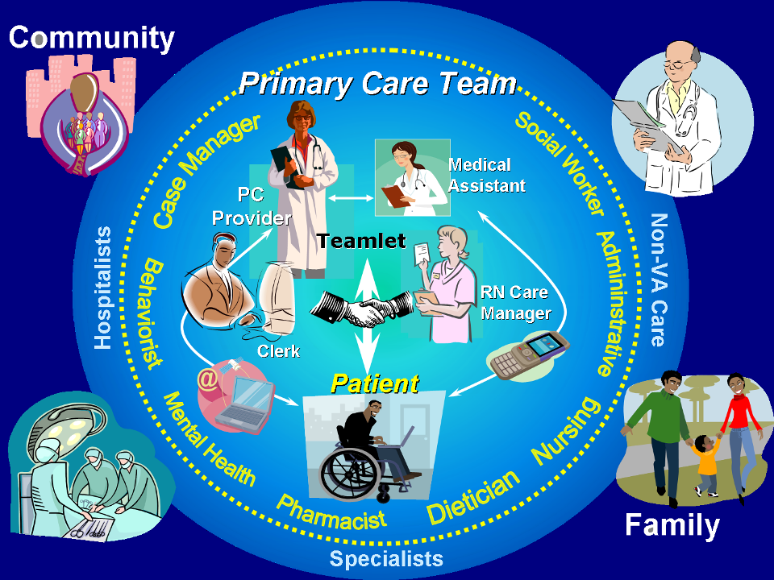
18
Notes:
Care delivered chiefly by the teamlet.
Broader team has additional members including the integrated Mental Health provider.

Slide 19
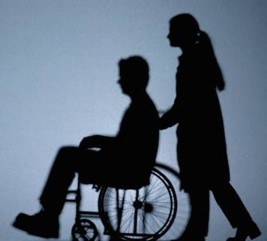
Essential Transformational Elements Patient Aligned Care Team
Delivering “health” in addition to “disease care”
Veteran as a partner in the team
Empowered with education
Focus on health promotion and disease prevention
Self-management skills
Patient Advisory Board
Efficient Access
Visits
Non face-to-face
Telephone
Secure messaging
Telemedicine
Others?
19
19

Slide 20
Essential Transformational Elements
Care coordination
Optimizes hand-offs between inpatient and outpatient care
Facilitates interface with specialty care
Seamless co-management (Dual Care) with outside providers
Incorporates tele-health, and HBPC services
Emphasizes home care & rural health

Slide 21
Essential Transformational Elements
Care Management/ Panel Management
Disease management and interface with specialty care
Chronic Care Model
Disease registries
Identification of outliers
Team RN partnering closely with providers
Veterans at high risk for adverse outcomes
Pain management
Returning combat veteran care
Depression
Substance abuse

Slide 22
Essential Transformational Elements
Improve technological clinician support
Decision support
Predictive modeling
CPRS user-friendliness
Information processing
Develop new measurement and evaluation tools
Patient Satisfaction
Staff satisfaction
Processes of care
Manager and Provider Report Cards
Continuity and comprehensiveness
22

Slide 23
Whole Person Orientation
“ …you ought not to attempt to cure the eyes without the
head or the head without the body, so neither ought you to attempt
to cure the body without the soul . . . for the part can never be well
unless the whole is well.”
Family and other supportive relationships
Physical abilities and limitations
Emotional, Spiritual, Psychological aspects
Work, recreation and other interests
Culture
Plato
Notes:
Plato quote: Ross, L. (1997) Nurses’ Perceptions of Spiritual Care. Aldershot: Avebury.

Slide 24
Mental Health is an Integral Part of Overall Health
Physical problems can be risk factors for mental health problems
Mental health problems can be risk factors for physical health problems
Patient Centeredness means a holistic view of the Veteran, recognizing the interrelationships of all health problems and how they individually and interactively affect quality of life

Slide 25
Expectations of the PC-MHI Team
Proficiency in Motivational Interviewing
Participate in appropriate Team activities
Huddles & Team Meetings
Frequent non-face-to-face phone contact
Keep entire Teamlet in the loop
Coordinate care with other VHA resources (i.e. CCHT, HBPC, ADHC, etc as appropriate)
Educate Primary Care Team on MH issues

Slide 26
Shared Medical Appointments
Potential new role for the co-located Mental Health provider
Provides patient-care in a group setting
Mental Health provider often assists with group management

Slide 27
Shared Medical Appointments
Have a component of education, but…
Alternative to the traditional face to face, 1:1 doctor:patient interaction in an office.
This doctor:patient interaction is in a group setting (“1:1 with onlookers”).

Slide 28
Shared Medical Appointments
One-on-one care with observers
15-20 patients in 90 – 120 min.
Patients learn from staff and from each other
Commonly facilitated by a Behavioral Health provider
Appeals to about ½ of those offered option

Slide 29
Conclusion
Patient Aligned Care Teams strive to provide patient-centered, whole person health care and seek to work with the Veteran to coordinate and manage all aspects of their care

Slide 30
Conclusion
Primary Care - Mental Health Integration is and will continue to be an essential component of the team delivery of effective care

